Slide 1
Electronics 1 Homework 3 from chapter 6
Mark Maddox
Electrical Engineering Program
University of Central Florida
mark.maddox2@ucf.edu
mark.maddox@analog.com

Slide 2

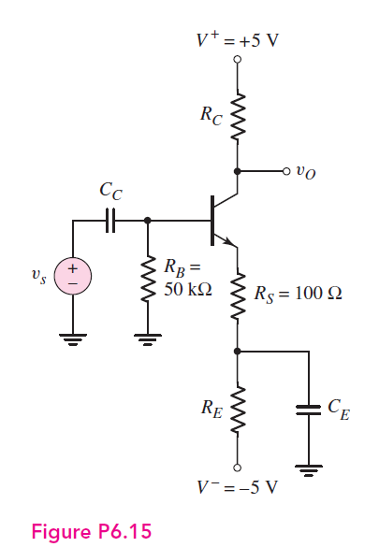

Slide 3
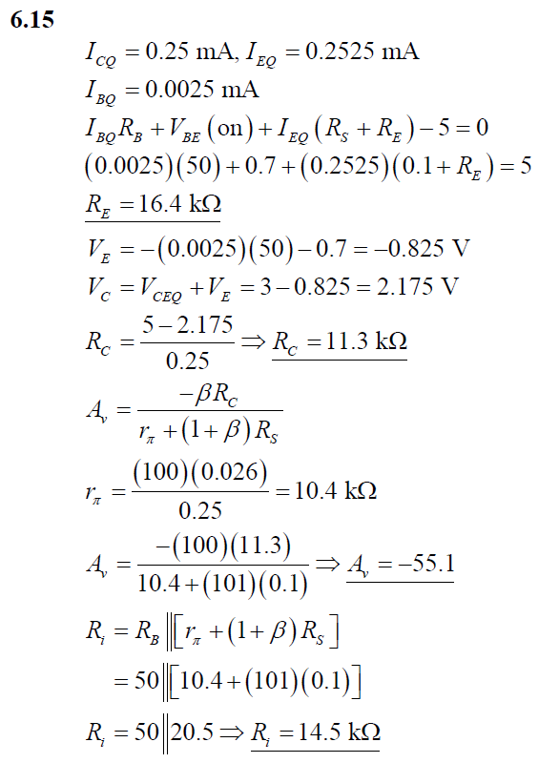

Slide 4
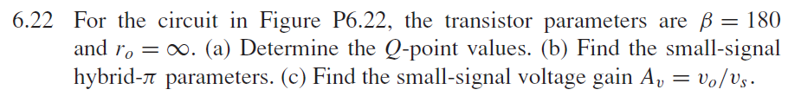
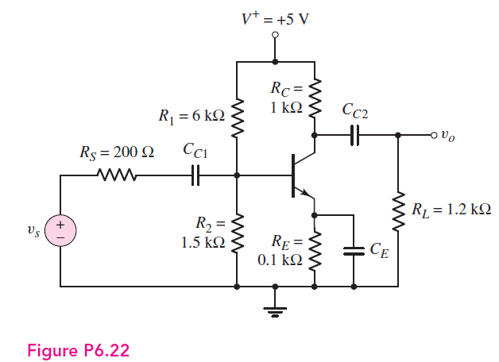
Note: The hybrid-π parameters are r_{π} and g_{m} where g_{m} = I_{c}/Vt and Vt = 25mV at 25°C

Slide 5
